Slide 2
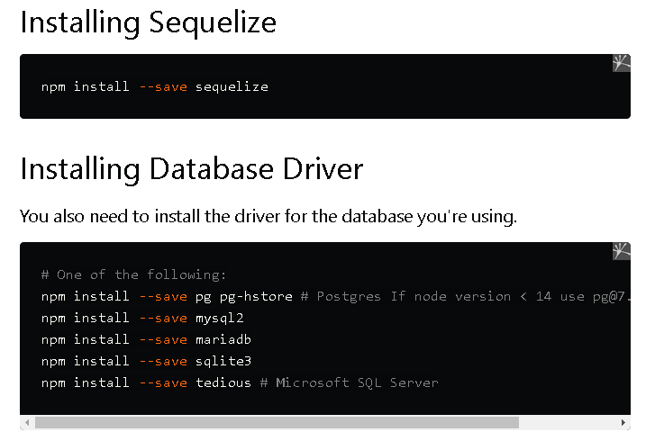

Slide 3
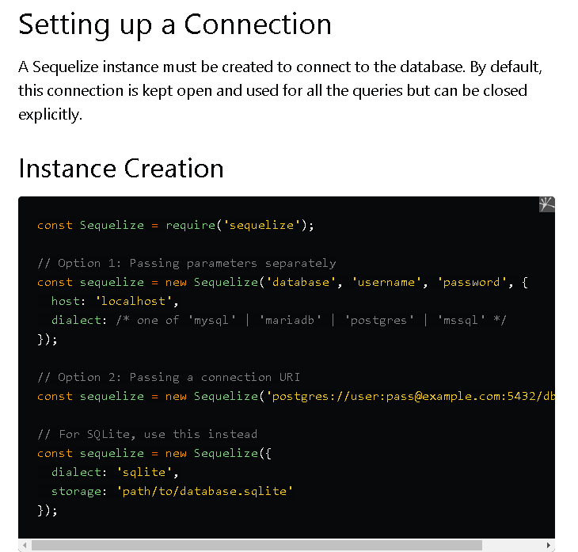

Slide 4
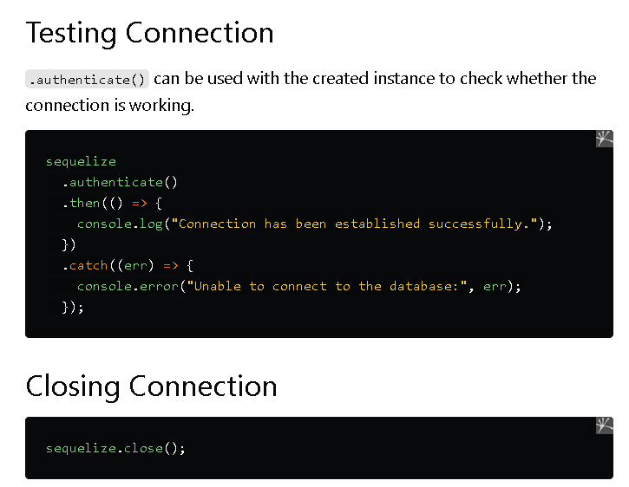

Slide 5
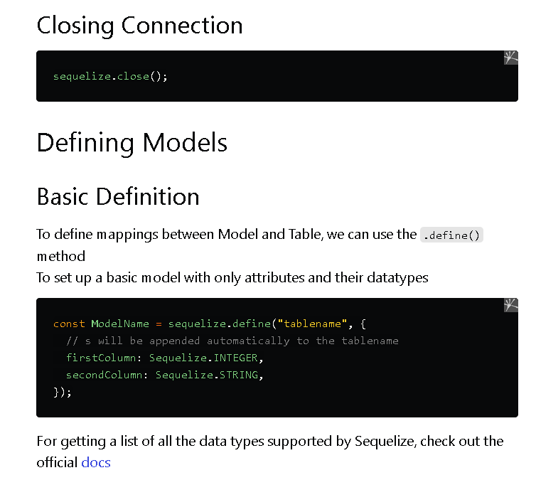

Slide 6
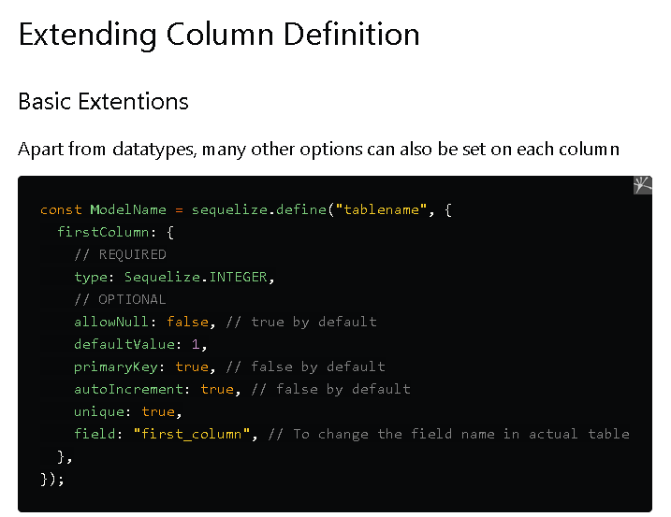

Slide 7
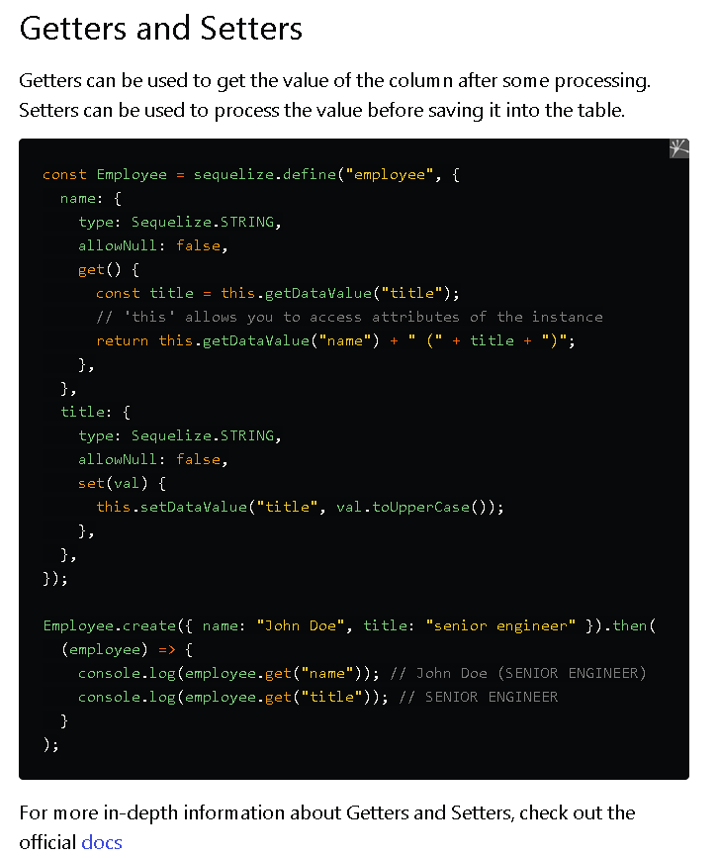

Slide 8
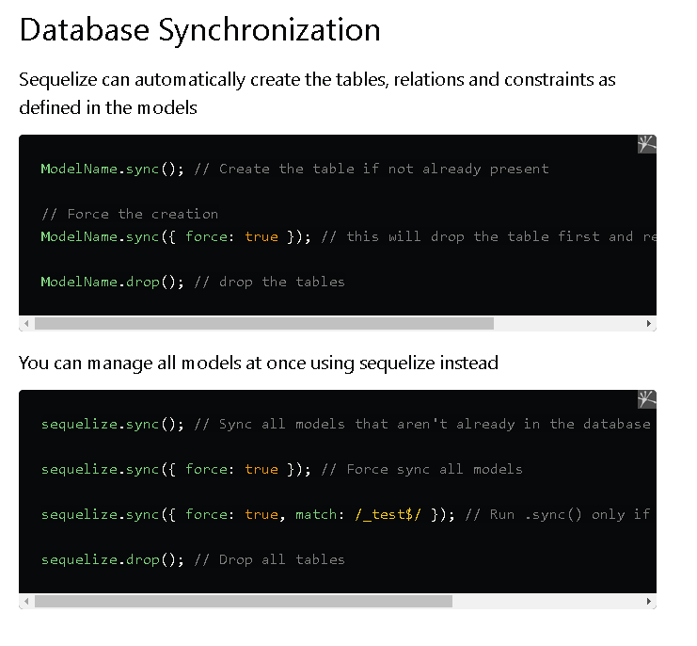

Slide 9
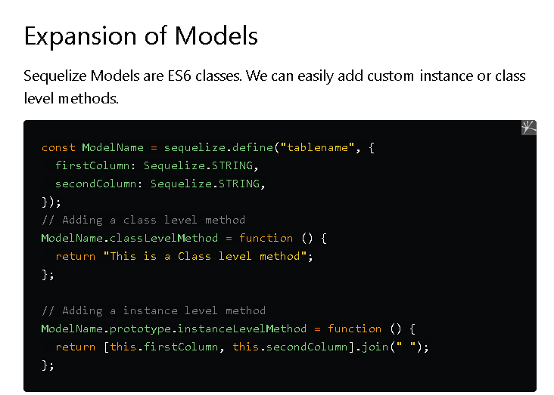

Slide 14
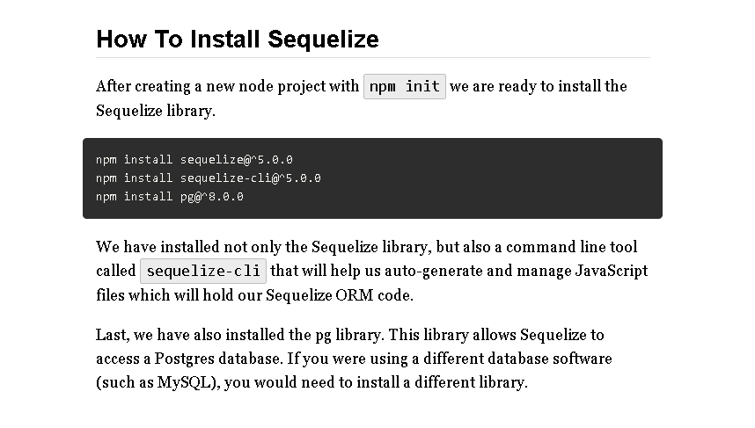

Slide 15
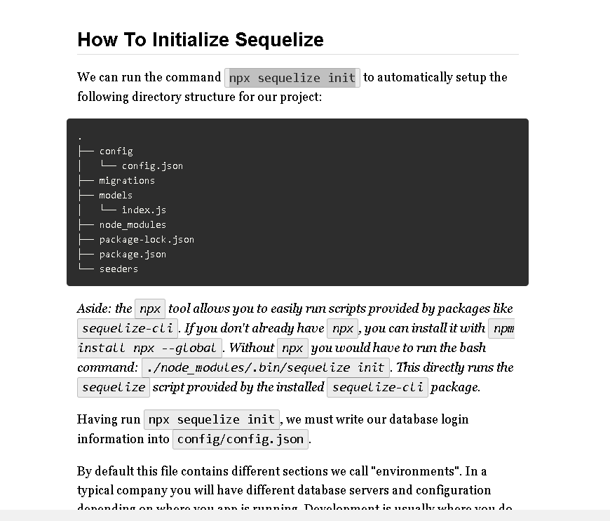

Slide 16
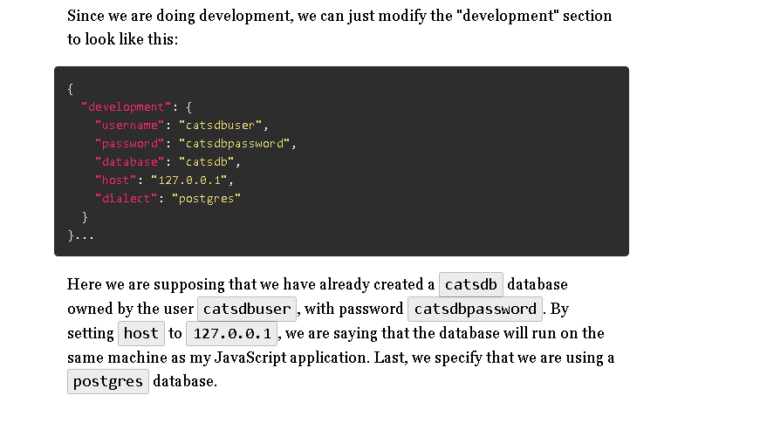

Slide 17
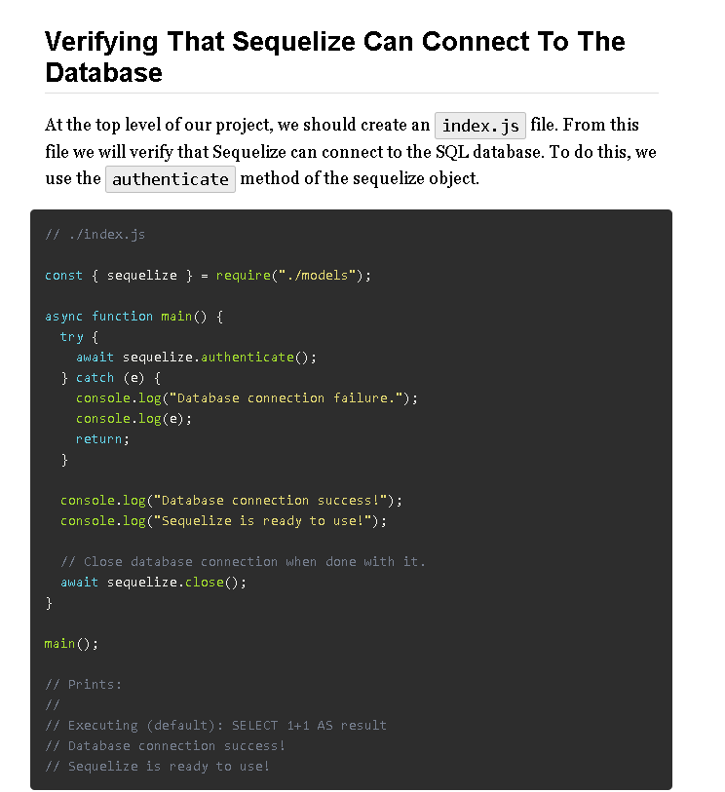
You may observe that the authenticate method returns a JavaScript Promise object. We use await to wait for the database connection to be established. If authenticate fails to connect, the Promise will be rejected. Since we use await, an exception will be thrown.
Many Sequelize methods return Promises. Using async and await lets us use Sequelize methods as if they were synchronous. This helps reduce code complexity significantly.
Note that I call sequelize.close(). This closes the connection to the database. A Node.js JavaScript program will not terminate until all open files and database connections are closed. Thus, to make sure the Node.js program doesn't "hang" at the end, we close the database connection. Otherwise we will be forced to kill the Node.js program with CTRL-C, which is somewhat annoying.

Slide 18
Using Sequelize To Generate The Model File
We will configure Sequelize to access the Cats table via a JavaScript class called Cat. To do this, we first use our trusty Sequelize CLI:
# Oops, forgot age:integer! (Don't worry we'll fix it later)
npx sequelize model:generate --name Cat --attributes "firstName:string,specialSkill:string"
This command generates two files: a model file (./models/cat.js) and a migration file (./migrations/20200203211508-Cat.js). We will ignore the migration file for now, and focus on the model file.
When using Sequelize's model:generate command, we specify two things. First: we specify the singular form of the Cats table name (Cat). Second: we list the columns of the Cats table after the --attributes flag: firstName and specialSkill. We tell Sequelize that these are both string columns (Sequelize calls SQL character varying(255) columns strings).
We do not need to list id, createdAt, or updatedAt. Sequelize will always presume those exist. Notice that we have forgotten to list age:integer

Slide 19
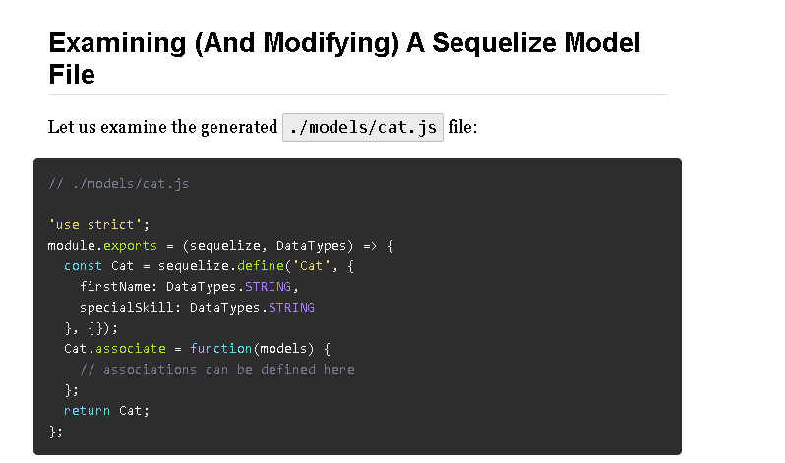
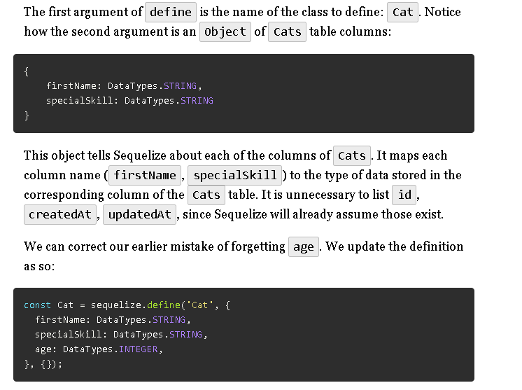
This file exports a function that defines a Cat class. When you use Sequelize to query the Cats table, each row retrieved will be transformed by Sequelize into an instance of the Cat class. A JavaScript class like Cat that corresponds to a SQL table is called a model class.
The ./models/cat.js will not be loaded by us directly. Sequelize will load this file and call the exported function to define the Cat class. The exported function uses Sequelize's define method to auto-generate a new class (called Cat).
Note: You may notice we aren't using the JavaScript's class keyword to define the Cat class. With Sequelize, it is going to do all that for us with the define method. This is because Sequelize was around way before the class keyword was added to JavaScript. It is possible to use the class keyword with Sequelize,

Slide 20
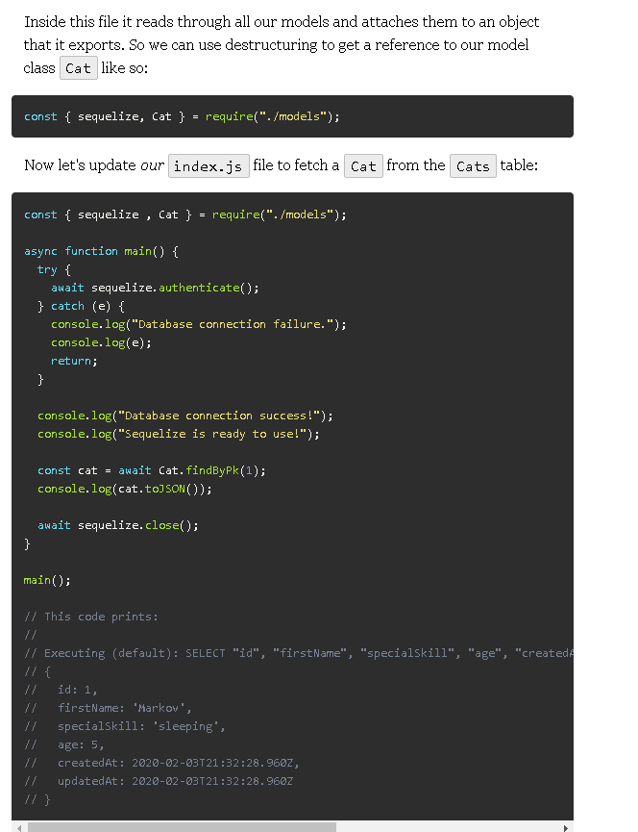
Using The Cat Model To Fetch And Update SQL Data
We are now ready to use our Cat model class. When Sequelize defines the Cat class, it will generate instance and class methods needed to interact with the Cats SQL table.
As we mentioned before we don't require our cats.js file directly. Instead we require ./models which loads the file ./models/index.js.
Inside this file it reads through all our models and attaches them to an object that it exports. So we can use destructuring to get a reference to our model class Cat like so:

Slide 21
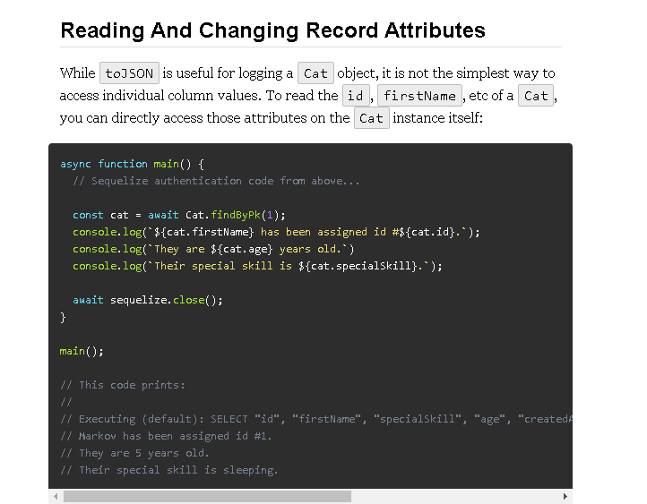

Slide 22
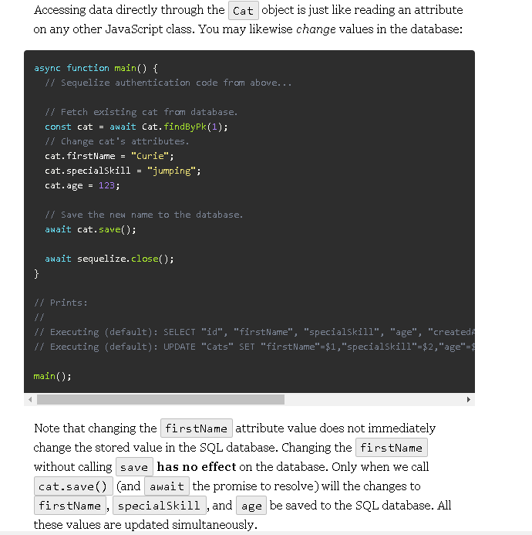

Slide 23
Database Migrations

Slide 24
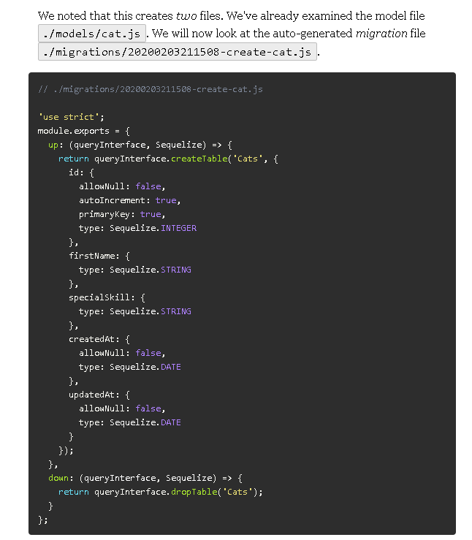
Sequelize Migration Files
In the prior reading we assumed that a Cats table already existed in our catsdb database. In this reading, we will presume that the Cats table does not exist, and that we have to create the table ourselves. This is the typical case when you aren't merely interacting with a preexisting database. When you develop your own application, the database will start out empty and with a blank schema.
We previously used the Sequelize CLI tool to autogenerate a Cat model file like so:
# Oops, forgot age:integer!
npx sequelize model:generate --name Cat --attributes "firstName:string,specialSkill:string"
We noted that this creates two files. We've already examined the model file ./models/cat.js. We will now look at the auto-generated migration file ./migrations/20200203211508-create-cat.js.

Slide 25
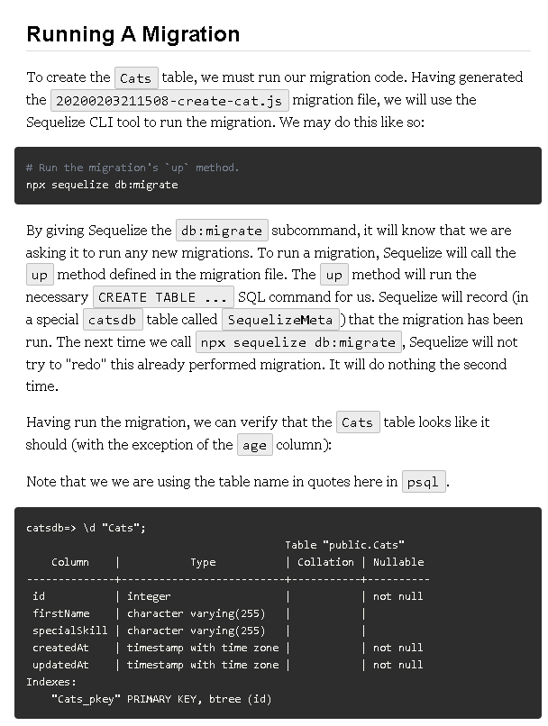

Slide 30
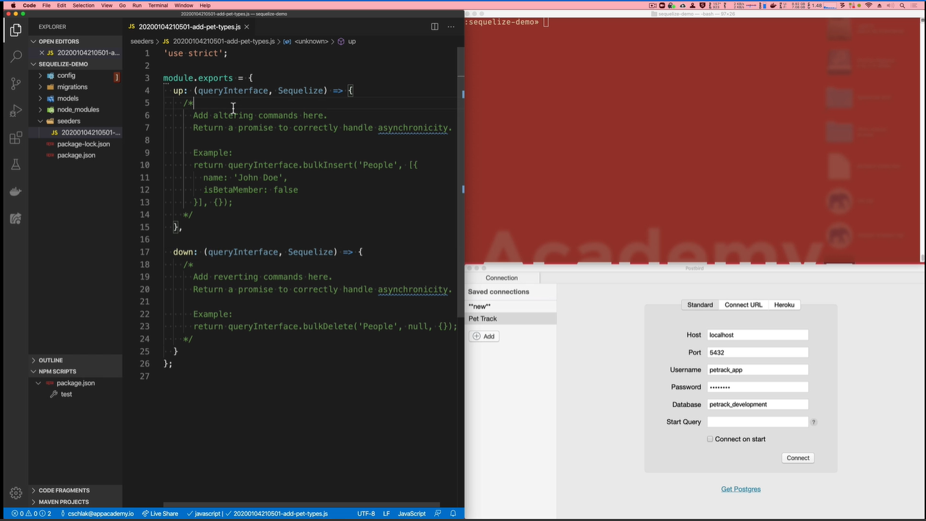
Inserting Data With Sequelize

Slide 31
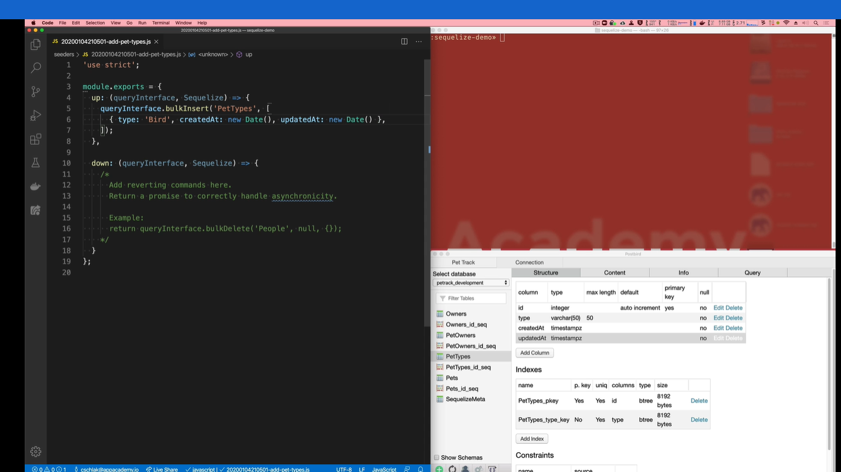

Slide 32
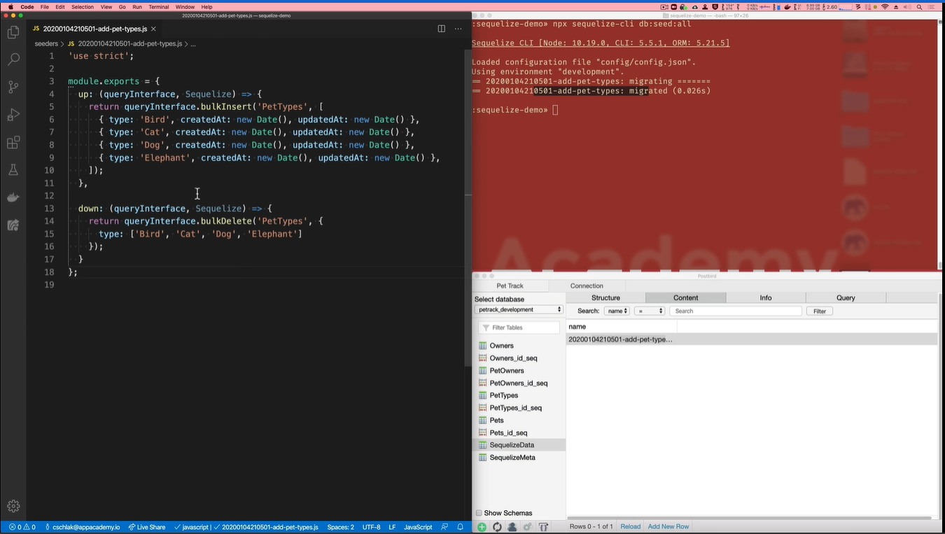

Slide 33
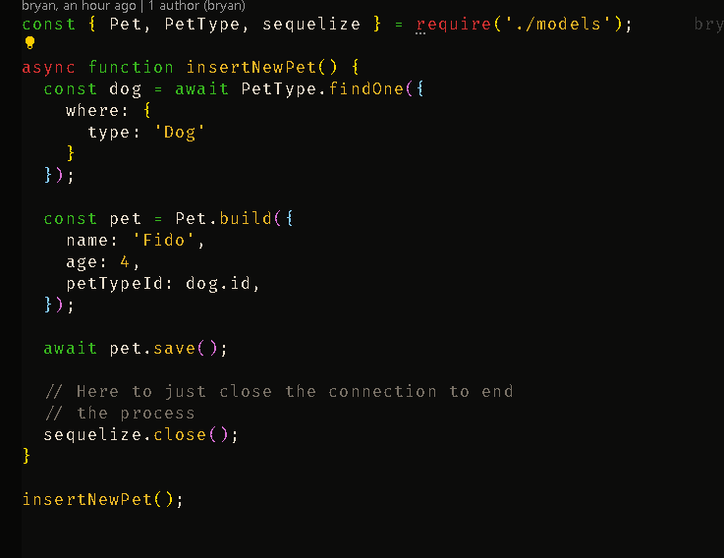

Slide 34
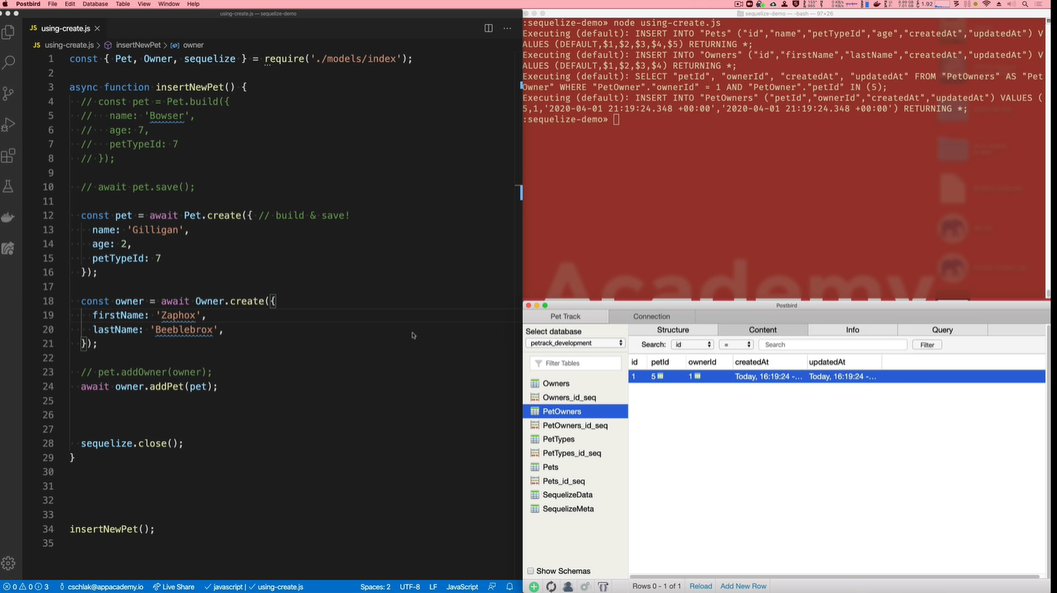

Slide 35
UPDATING DATA

Slide 57
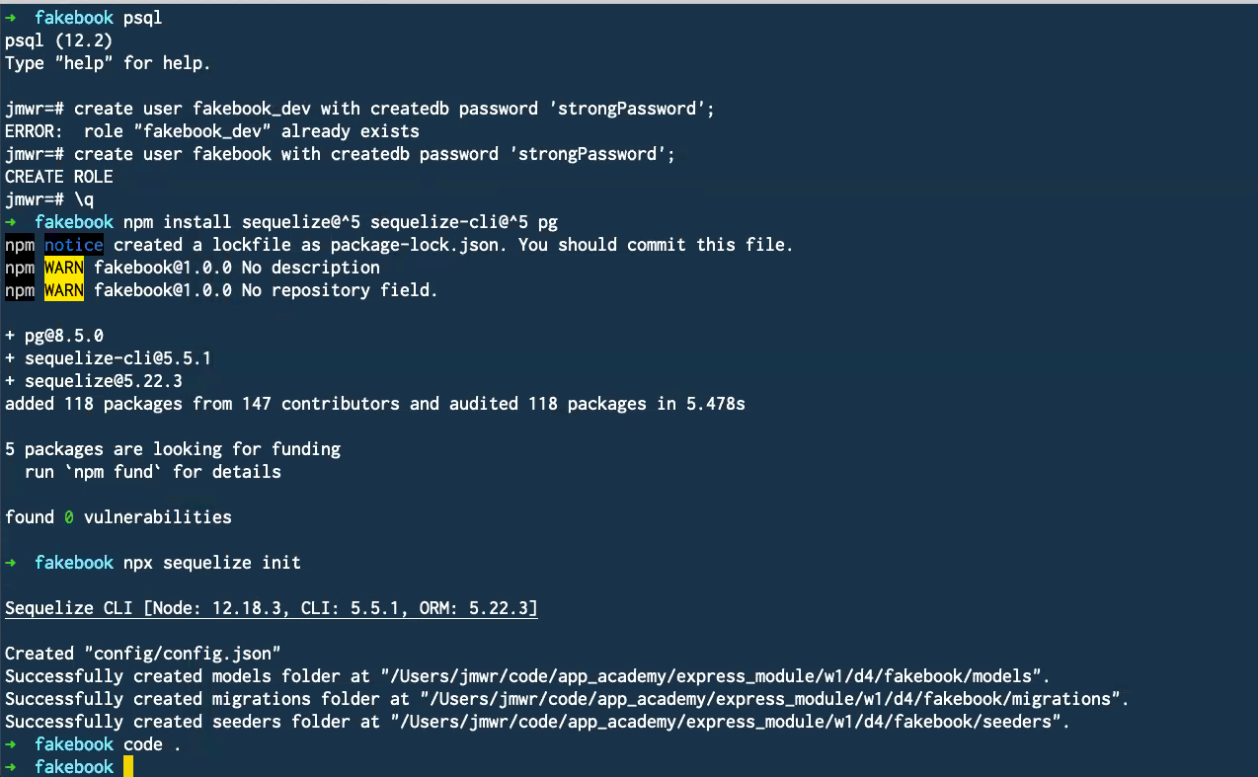

Slide 58
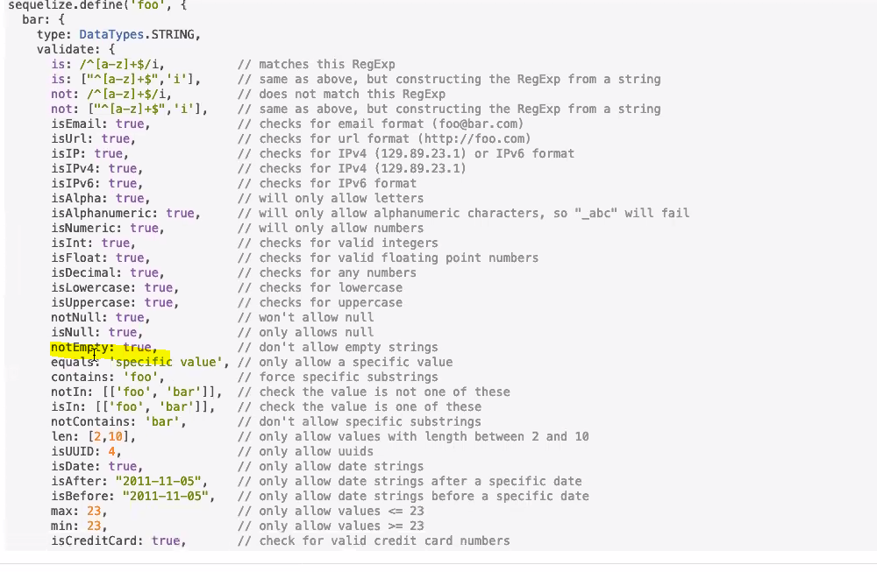

Slide 59
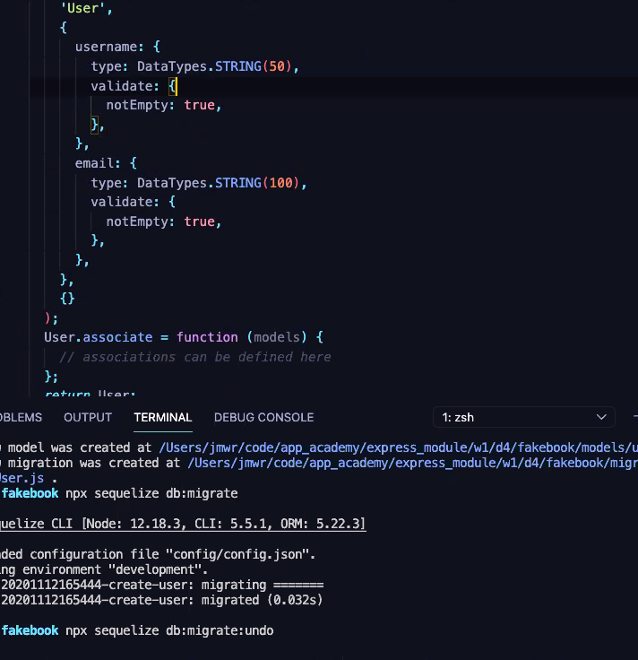

Slide 60
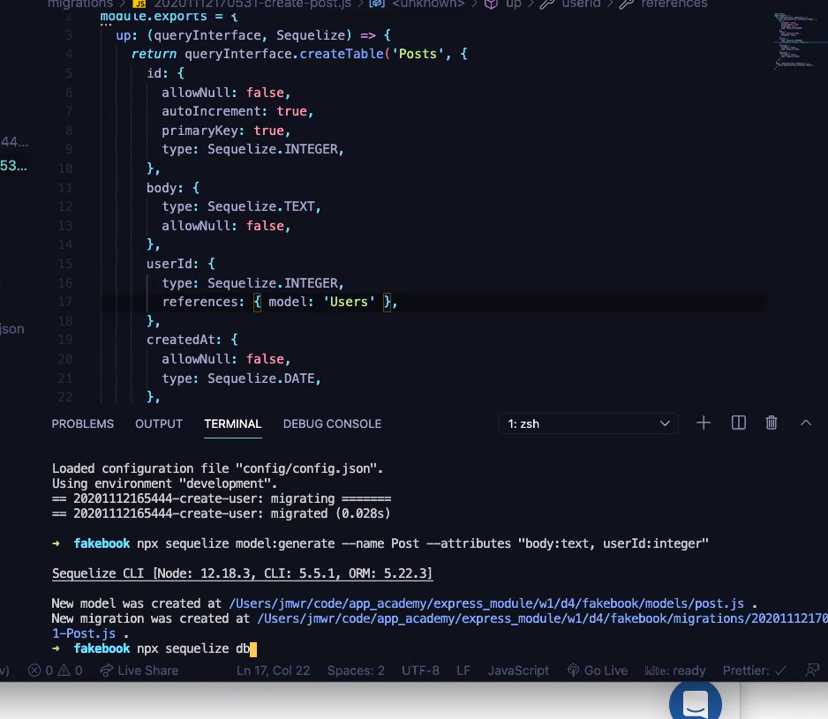

Slide 61
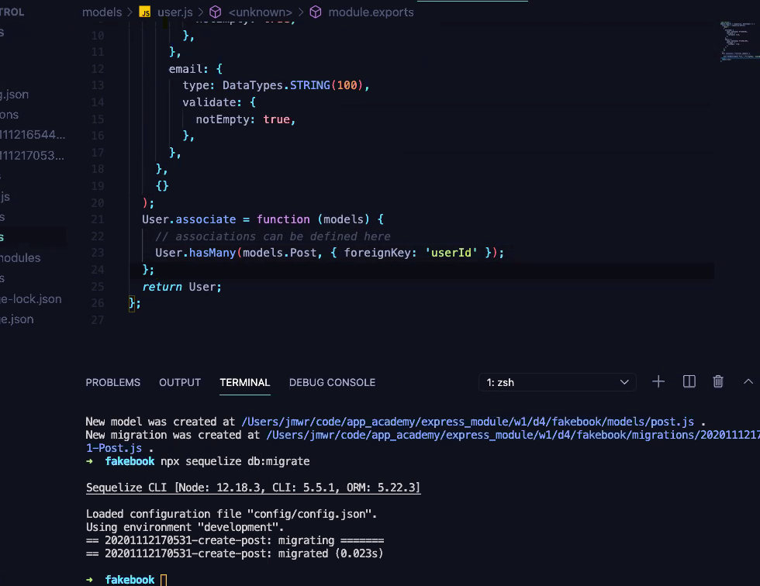

Slide 62
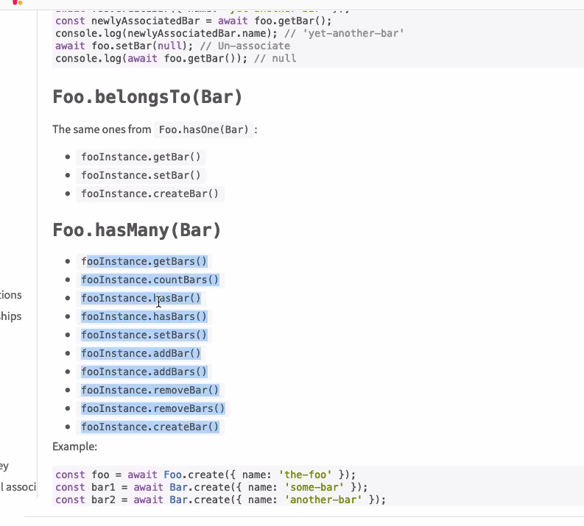

Slide 63
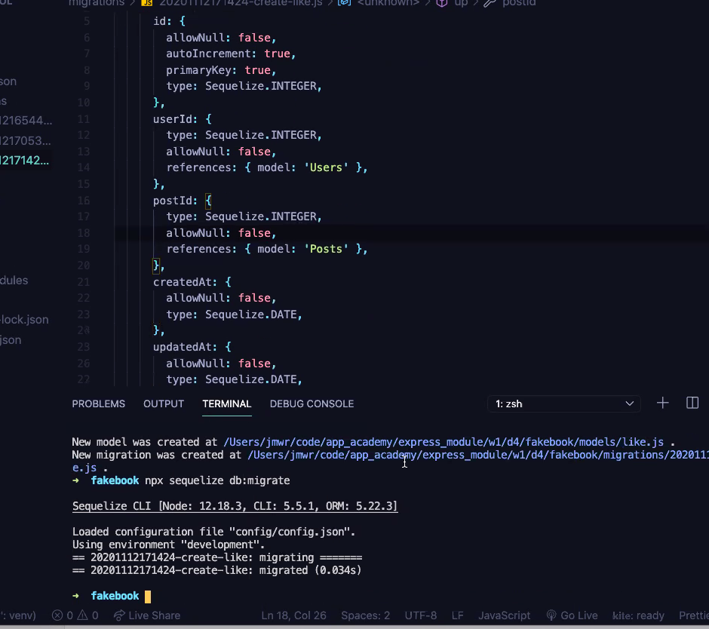

Slide 64
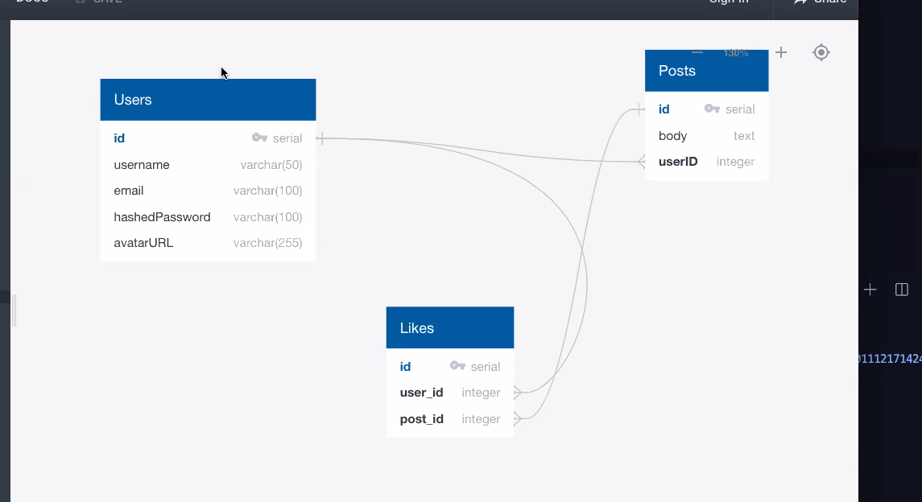

Slide 65
